Slide 1
Lecture 4

Slide 2
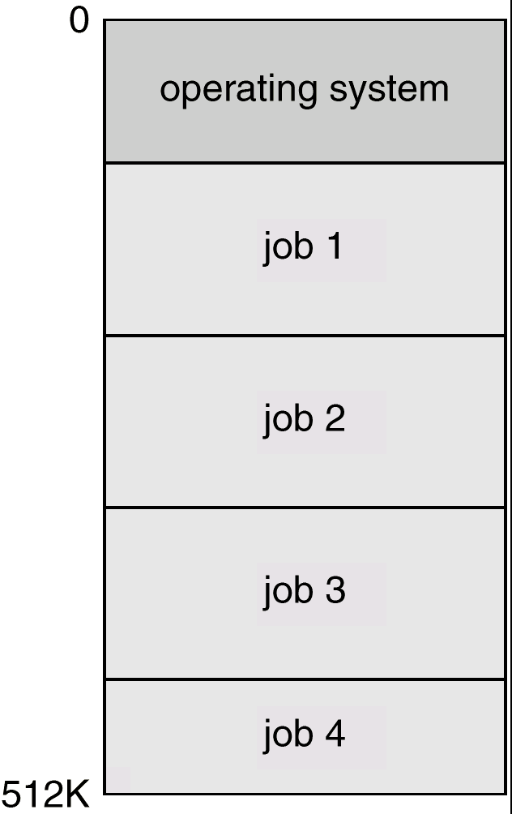
Multiprogrammed Batch Systems
Several jobs are kept in main memory at the same time, and the
CPU is multiplexed among them.

Slide 3
OS Features Needed for Multiprogramming
I/O routine supplied by the system.
Memory management – the system must allocate the memory to several jobs.
CPU scheduling – the system must choose among several jobs ready to run.
Allocation of devices.

Slide 4
Time-Sharing Systems–Interactive Computing
The CPU is multiplexed among several jobs that are kept in memory and on disk (the CPU is allocated to a job only if the job is in memory).
A job is swapped in and out of memory to the disk.
On-line communication between the user and the system is provided; when the operating system finishes the execution of one command, it seeks the next “control statement” not from a card reader, but rather from the user’s keyboard.
On-line system must be available for users to access data and code.

Slide 5
Personal-Computer Systems
Personal computers – computer system dedicated to a single user.
I/O devices – keyboards, mice, display screens, small printers.
User convenience and responsiveness.
Can adopt technology developed for larger operating system’ often individuals have sole use of computer and do not need advanced CPU utilization of protection features.

Slide 6
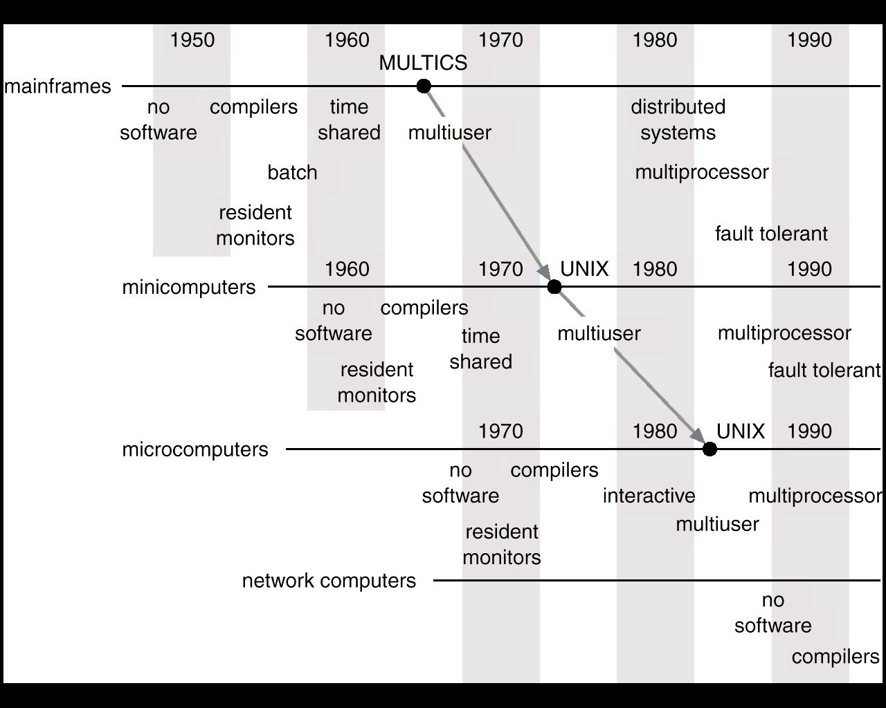
Migration of Operating-System Concepts and Features

